Slide 1
10/02
John

Slide 2
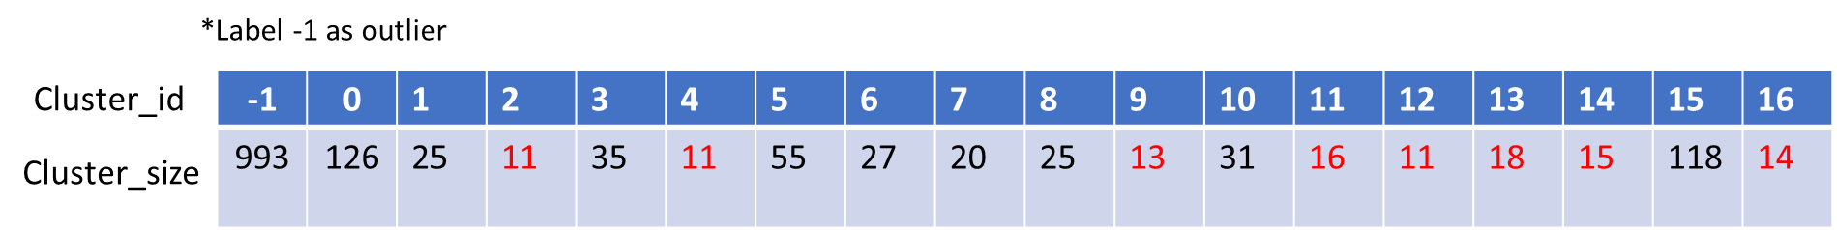
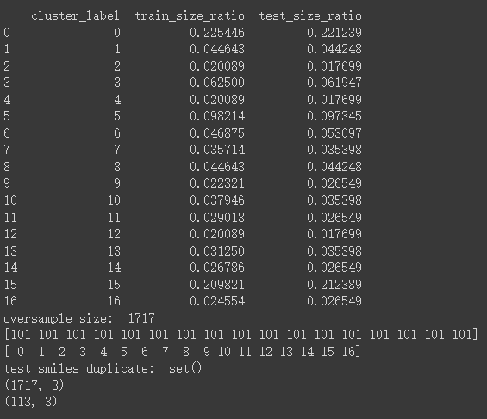
Remove HBDSCAN label: -1 (considered noise), then oversampling other classes

Slide 3
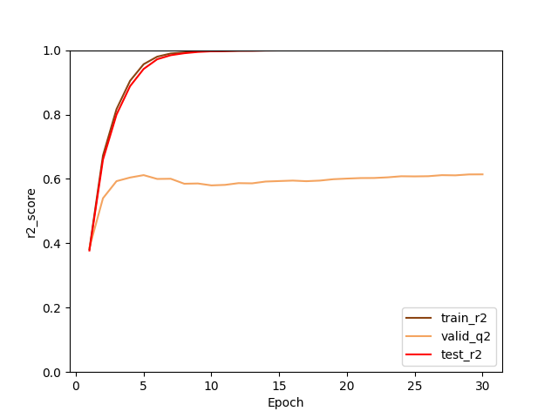
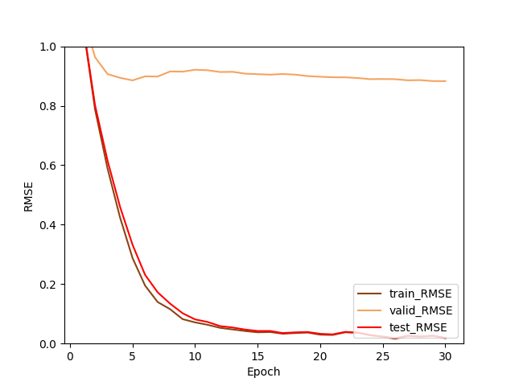
Remove HBDSCAN label: -1 (considered noise), then oversampling other classes

Slide 4
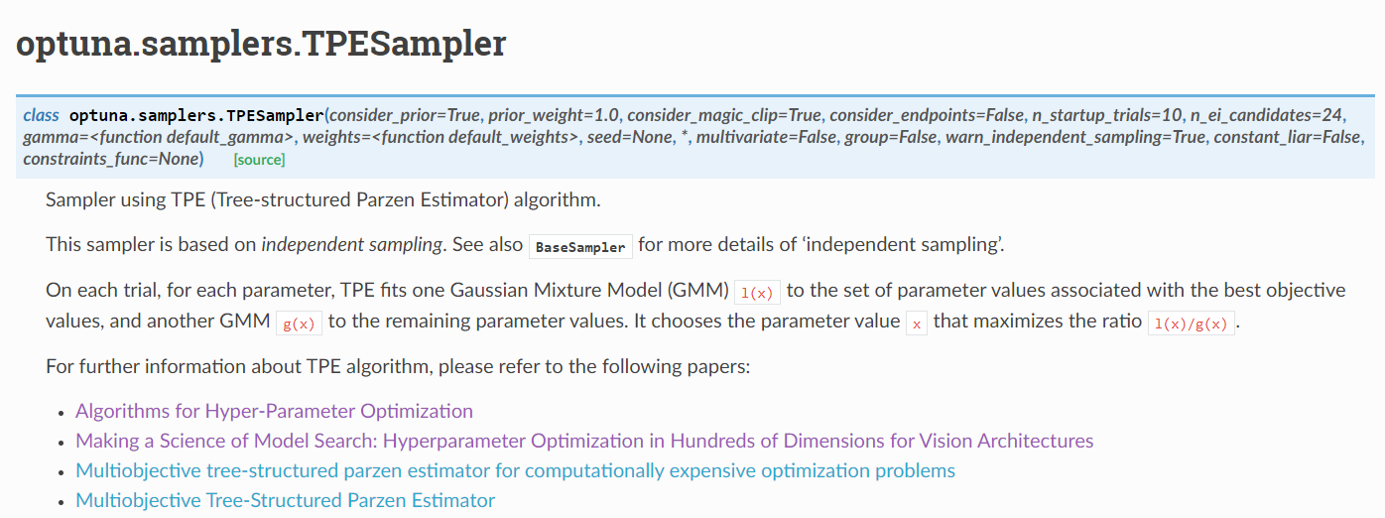
Try adding TPESampler/model.restore() into model but not well

Slide 5
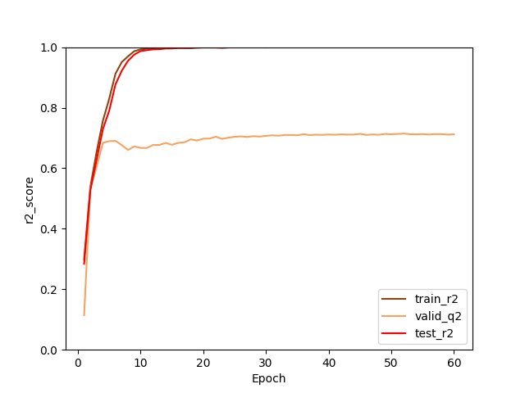
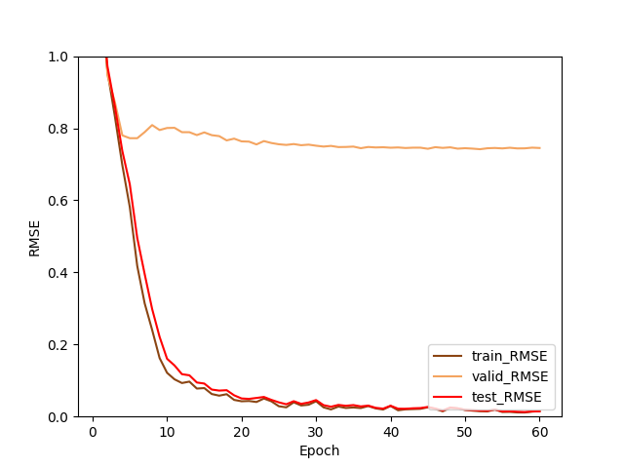
Final DMPNN model Best result
Best
Train r2: 0.999878639
Valid q2:0.999861054
Test r2: 0.714415234
Best
Train RMSE:0.014755547
Valid RMSE: 0.016348281
Test RMSE: 0.741796877

Slide 6
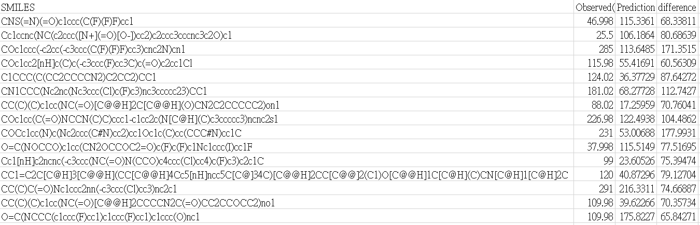
Difference bigger than 60, total 15 compounds

Slide 7
